Slide 1
Interview-2
DEP-Preparation
Elva Li

Slide 2
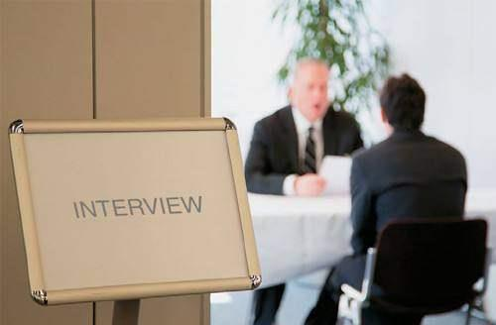
CONTENTS
1
Review
2
Interview Topics
3
Interview Language
4
Mock Interview Practice

Slide 3
CONTENTS
Review
1

Slide 4
Review
EOS Speaking Assessment
IELTS Speaking Test
Band Descriptors
Interview Techniques

Slide 5
CONTENTS
Interview
Topics
2

Slide 6
34 Topics
14 frequently tested topics
Hometown & Accommodation
Work/Studies
Museums
Daily life
Time
Animal
Flowers
Color
Music
Films
Science
Collecting
Painting
...
Notes:
必考话题：14个
Hometown & Accommodation
Work/Studies
Museums Daily life Time Animal
Flowers Color Music Films
Science Collecting Painting

Slide 7
34 Topics
20 hot topics
Birthdays
Handcrafts
Names
Computers
Happiness
Driving
Photo
Gifts
Housework
Language
Internet
Dancing
Swimming
Activities
Meals
Birds
Weather
Concerts
Holidays
Driving

Slide 8



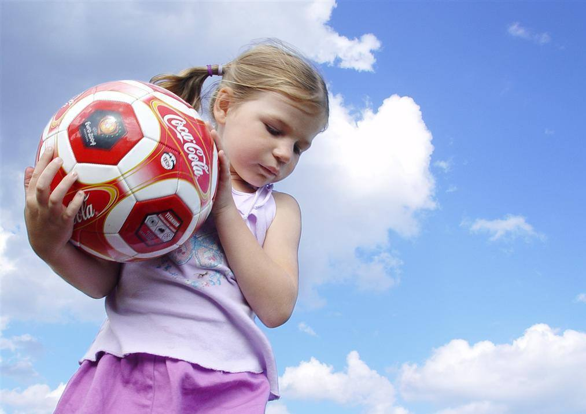
3 Topics
Three
Common Topics (Exam Part 1)
Work/Study
Home/ Hometown
Hobby/ Interest

Slide 9
CONTENTS
Interview
Language
2

Slide 10

Interview Language
Give longer responses.
Put your answers in sentences.
Use fillers and redundant language.
Don’t recycle vocabulary.
Try to speak in degrees.
Ok, then; actually; alright; well, you know;
To some extent, In some degree, In a sense

Slide 11
EOS Speaking Assessment
EOS Speaking Test Questions
A.
53 Questions - You may need to answer 1-2 long questions depend on how long you would spend for each question.
Component - Part 1
B.
Identity - Student Name, ID and some general questions about you.
Component - Part 2
C.
Assessment Question(s) - 1 or 2 long questions

Slide 12


EOS Speaking Assessment Part 1
1
2
Self-introduction
General questions on topics:
Study
Hobby/ Interest
Home/ Hometown

Slide 13

Learn to Introduce Yourself
How would you give an introduction?

Slide 14

Learn to Introduce Yourself
Your name and its special meaning
Your school, major / favorites subject
Your family
Your hometown
Your hobbies and interests
Your future plan / destination country
……

Slide 15
Learn to Introduce Yourself
Life
Hobby
Dream
Life
Hobby
WHO
Name
WHERE Hometown/Native Country
WHAT Character&Personality
WHAT Hobby
WHY The main reason you choosing that hobby
WHEN When you usually do that hobby
Dream
WHAT What our dream is
WHEN When we want to reach that dream
WHY Why we chose the dream

Slide 16
Learn to Introduce Yourself
Life
Hobby
Dream
Life
Hobby
WHO
Peter
WHERE
Spain
WHAT
Diligent & Outgoing person
WHAT Playing the piano
WHY I love classical music
WHEN Every evening after work
Dream
WHAT Travel all around the world
WHEN Over the next 10 years
WHY I have always loved meeting new people and learning about new cultures.

Slide 17

Hobby & Interest
Question Patterns
What do you like to do in your spare time?
Do you have any interest?
What do you do when you are available?
What do you do for relaxing?

Slide 18
Hobby & Interest
Structure
1. In my spare time, I’d like to...
2. Well, in general I would say that…
3. In addition to this I suppose I’m also pretty fascinated
by…, and this is because of the fact that …
4. To be more precise/specific…
5. And I guess this is probably because…

Slide 19


Hobby & Interest
Expressions
have a passion for...
be (quite) passionate about...
be (really) keen on...
be (pretty) fond of...
a big fan of...
be totally crazy about...
find … fascinating.
be (quite) enthusiastic about...
be into sth.
…never fail(s) to fascinate me.
I’m not really satisfied with …
I’m not much of a fan of …
I’m not really fond of …
… is simply not my cup of tea.
I totally hate…
I really can’t stand…
I absolutely feel bad/terrible about…
… simply get(s) on my nerves.

Slide 20

Hobby & Interest
accumulate knowledge
broaden one’s vision
let imagination run wild
relax one’s body and minds
Hobby & interest can bring us...
build up/strengthen one’s muscles
increase one’s metabolism
put sb. into pleasurable emotions
cultivate one’s temperament

Slide 21

Hobby & Interest
In my spare time, I’d like to play basketball. Because it can exercise my body and can also relieve my pressure from studies. I still remember the first time I played basketball，which really pumped me up. That’s what I like to do.

Slide 22




Hobby & Interest
dancing
sports
reading
Do you like…
photography
jogging，rafting，
shopping…

Slide 23
Hobby & Interest
Do you like watching TV?
Yes, I guess I’m quite fond of watching TV.
Yes, I really like watching TV.
For the most part, I would probably say that I quite like watching TV…
To some extent, I would say I like watching TV.
Well, I wouldn’t say I actually like watching TV.
Well, I suppose you could probably say that I’m fond of watching TV.
Well, it’s hard to say, I don’t “like” watching TV but I’d actually spend quite a lot of time sitting in front of a TV set, just to kill time really.

Slide 24
Hobby & Interest
No , I’m afraid not. Although … (hobby in the question) is a good hobby, … (another different hobby) takes most of my leisure time. Specifically, I … per week/day (frequency). I can hardly spare anytime on other activities. (Anyway, some of my friends they are keen on…(hobby in the question), I guess I would have a try later)
Actually, I can’t give you a specific answer. Cos there are many excellent… But recently , I am …. And it’s amazing. So to some extent ,…is my best love right now.

Slide 25


Work & Study
1
What’s your future plan?
2
Do you like your major?
Why do pick up this major? Job?
3
Are you working or are you a student?
I study at…in…
I work in/as/for…

Slide 26

Work & Study
Work
Stable salary
A good welfare system
Win social respect
Study
Knowledgeable and professional
professor
Hot major
Interested/fascinated
work & study can bring us...

Slide 27
Work & Study
Future Plan
Do you plan to spend many years overseas?
What work would you like to do after you finish your studies?
My ideal major is …when I was a child, I adored… . Also …(major) is advanced in …(country), so I want to have my further education in ..
I hope to become a/an … in the future.
Notes:
陈述起源：My ideal major is …when I was a child ,I adored… . Also …（专业名）is advanced in …(国家), so I want to have my further education in ..
道出理想： I hope to become a … or a … in the future.

Slide 28
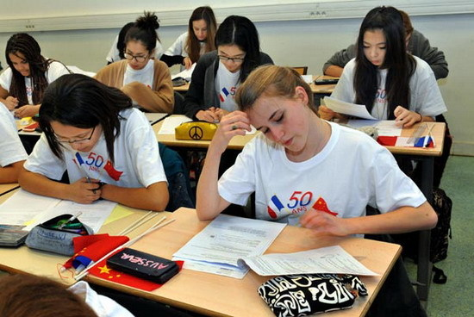
Work & Study
You Study
What subject(s) are you studying?
Why you choose your university?
How do you like your subject?
What's the most difficult/easiest part of
your course?
Are there any particular skills that you learn
in your study?
Tell me about your student life.
Do you prefer studying independently or with others?
Why do you plan to go abroad?

Slide 29

Work & Study
Your Study-1. WHAT
What is your major?
Which subject is your favourite? Why?
English, Chinese, Maths, Chemistry, Physics, Biology, History, Geography, Politics, Painting, Physcial Exercise, Accounting, Finance, Economics, Design, Fundamental of Psychological Statistics, History of Psychology, Cognitive Psychology, Psychology Counseling, Educational psychology…

Slide 30
Work & Study
Your Study-2. WHY
Why did you choose to study that?
My university has a great reputation in China.
Students who graduate from my major are able to get more chances to find decent jobs.
This is a pretty promising field.
The professors are quite responsible and amiable.
I plan to work in this industry.
The courses are quite beneficial. I learn a lot.
I adore English, I think I got talents in it.

Slide 31
Work & Study
Your Study- 3. Do you...?
Do you like your major?
Do you think that's a difficult subject to study?
How do you feel about…?
I kind of like
I'm into,
I love/adore
I'm fascinated by…
I'm not keen on…
I dislike, xx is not my cup of tea.
Yes and no, I can't say for sure,
Maybe or maybe not
It depends. On the one hand,...
I'm not sure…
It seems like...
It's kind of complicated.
xxx may vary from person to person.

Slide 32
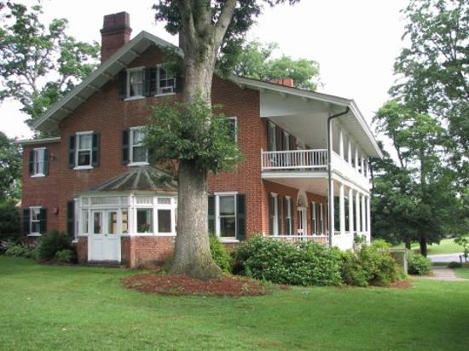
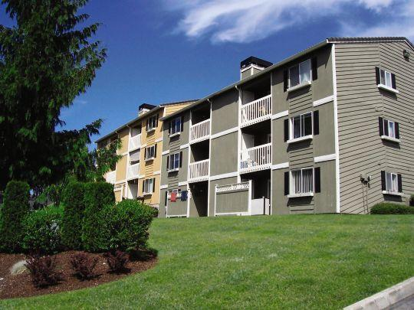
Home & Hometown
Home
Do you live in a house or a flat / apartment?
Could you describe your home/current accommodation?
Q: What is the difference between a house and an apartment?

Slide 33
Home & Hometown
Room
Which is your favorite room?
Answer + Explanation (Describe the room)
Rooms:
Bedroom
living room
sitting room
bathroom
Kitchen
Dining room
Study
Balcony
1. Favorite→I enjoy/like
The room I like most is +Why
2. Non-defining attributive clauses
I live in… , which consists of …
Notes:
I live in an apartment.
答案+解释（房间描述）
I live in an apartment , my home is very big.
房间名称：
Bedroom/ living room /sitting room/ bathroom / kitchen / dining room/ study
本题可运用高分句型：非限定性定语从句
I live in …（+地点）, which consists of …

Slide 34
Home & Hometown
Family/Friends
What do you do with your friends/ family?
How would you spend your time with your friends / family?
Do you like to be with your friends/family?
Answer + Explanation + Examples (things you did recently)

Slide 35
Home & Hometown
Hometown
Could you say something about your town?
What kind of place is your hometown?
???
My city is .., it’s very beautiful and big.
The people there are very friendly.
★Focus on one feature + Detailed Explanation
History: It has been established …years ago, and it goes back to … dynasty.
…was named the capital of China several times by many dynasties.
Geography/Location: It is located in …in.. Province and it’s an ideal location,
near/close to …. Transportation is easy and convenient
Gorgeous Scenery: trees and flowers everywhere, fresh air, gentle breeze;
Notes:
回答一定要有主线，不要东说一句，西说一句。

Slide 36
Home & Hometown
Hometown
Tell me about the house/flat that you live in.
Start with 1 point:
Ok, then; actually; alright; well, you know
The first thing I should mention is that …
The point I’d like to begin with is that …
I could start off by saying that …
My initial point would be that …
The main thing you need to know is that …
I suppose I should begin by highlighting the fact that …
I really need to kick off with the point that …

Slide 37
Home & Hometown
Hometown
Tell me about the house/flat that you live in.
2nd pointing phrases:
Another point which I could add is that …
A second feature which I should mention is that …
Also, I could say that …
On top of that… I could also add that …
In addition I suppose I should say that …
3rd pointing phrases:
And I shouldn’t forget to mention that …
Something else that I need to comment on is that …
I guess I could also remark on the fact that …

Slide 38
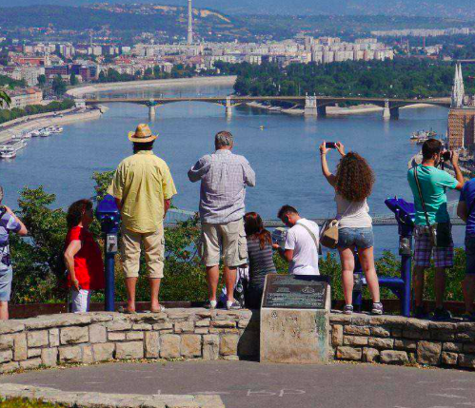

Home & Hometown
Tourist Attractions
What are the famous attractions in your town?
e.g.
There is a tower in my hometown. It is very famous.
The attraction
+
Why it’s famous
+
Tourism effects
Notes:
此题注意修饰词 famous， 答案中要有体现
景点+出名原因+旅游效果

Slide 39
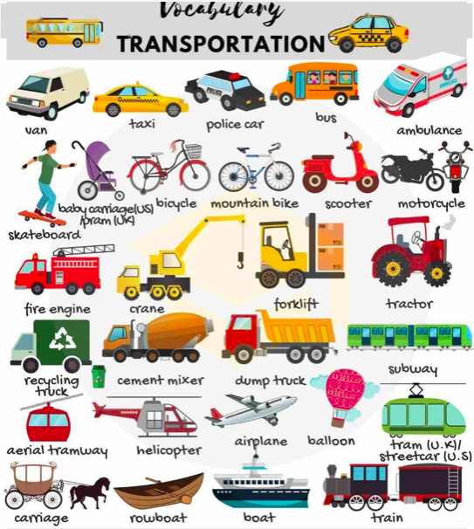
Home & Hometown
Transportation
What sort of transportation do you use daily?
Convenient
Good for my health, refresh my body
A reasonable amount of exercise prepares a good sleep
Do no harm to the environment

Slide 40

“Type of” Questions
Home & Hometown
Transportation
Tell me about the different types of public transport in your city.
There are buses, taxies, motorcycle taxies, trains, the Underground/the subway/the tube/the Metro, planes, ferries and mini-buses.
What’s a better answer???
1. Opening Phrase
Well actually …
Of course you know …
OK, certainly …

Slide 41

Home & Hometown
Transportation
Tell me about the different types of public transport in your city.
2. Then use one of the following …
… there’s quite a mixed variety of …
… there’s quite an extensive diversity of …
… there’s quite a wide range of …
… there’s a fairly broad range of …
… there’s quite a diverse mixture of …

Slide 42
Home & Hometown
Transportation
Tell me about the different types of public transport in your city.
3. Now use the following structure to introduce the first type:
But I guess the most +adj. … would probably be…
However, I suppose the most + adj. … could possibly be…
Yet I imagine the most +adj. …may well be…
Still, I suspect the most +adj. … could perhaps be…

Slide 43
Home & Hometown
Transportation
Tell me about the different types of public transport in your city.
Common
Fashionable/Famous/Trendy/Up-to-date
Widely-used/Commonly-used/Frequently-used
Adj.
Popular/Widespread
Standard
Usual
Current
Best-selling
Influential
Crucial
renowned

Slide 44
Home & Hometown
Transportation
Tell me about the different types of public transport in your city.
4. Then use a phrase to add a detail: Provide reasons
What causes … is that…
I assume … are so + adj. because…
And the explanation for this could be that …
And the basis of this is that …

Slide 45
Home & Hometown
Transportation
Tell me about the different types of public transport in your city.
Of course, you know there’s quite a mixed variety of public transport, though I think the most adj. … would potentially be ... And the explanation for this could be that …
Another form of public transport that’s worth mentioning could be … and the main feature of ... is that …(details).

Slide 46
Practice
Let’s try on EOS speaking Part 1
1. Could you please introduce yourself?
2. Short answer questions.

Slide 47

Other Useful Expressions
Opening and transitioning
There are several reasons for …
This is a big topic. Let me see…
Well, that’s hard to say.
What an interesting question!
To start with, First, Second/in addition/also/furthermore/…
After that…then…
In conclusion

Slide 48




Other Useful Expressions
Comparing
e.g. In what ways magazines are different to newspapers?
Obviously there are a number of clear
differences/distinctions…
...whereas in contrast…
…while on the other hand…
…alternatively…
…then in opposition…

Slide 49
Other Useful Expressions
Predicting
e.g. What will schools be like in the future?
I’m sure that in years to come we will see a number of great changes related to this.
I imagine in the not so distant future there are going to be a few imminent changes.
It could be possible that…
There’s even a chance that…
I know it’s a bit of a crazy thought, but one day maybe we could…

Slide 50
Other Useful Expressions
Why Questions
There are probably a number of factors involved
There are unquestionably a number of explanations for this.
There are undoubtedly a variety of justification of this.
e.g. Why do people like traveling to foreign countries?

Slide 51
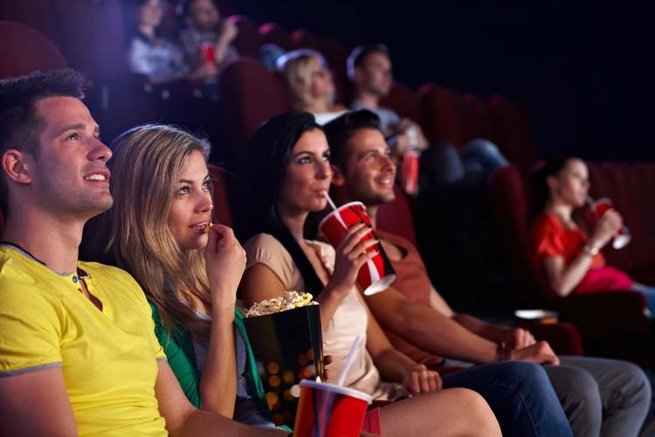
Other Useful Expressions
How Often Questions
How often do you go to the cinema?
It depends…
Well to be honest, I would have to say that it really depends. Like for instance…, whereas in contrast…
I think I would have to say that it really depends.
I imagine that it would depend on the situation.
Basically…but…
Basically, + (the first answer that pops up in your head.）
But …

Slide 52
Other Useful Expressions
How Often Questions
How often do you go to the cinema?
Select the following:
If (situation A) …, then I will most likely …
If (situation A) …, then it’s quite possible that I will …
If (situation A) …, then I guess it’s quite likely that I will …
Then introduce “Situation B”:
If (Situation B) …, then it’s more likely that I’ll…
If (Situation B) …, then I will definitely …
If (Situation B) …, then I will most certainly …

Slide 53
Other Useful Expressions
Advantages & Disadvantages
Advantages
e.g. What are the advantages of living in cities?
There are quite a few benefits.
Clearly there are a number of obvious merits.
Sure there are a few favorable aspects.
Obviously there are a number of positive features.
Disadvantages
e.g. What are the disadvantages of living in an old building?
I think it’s fair to say there are a few negative aspects.
I think there are a few drawbacks.
Of course there are some shortcomings.

Slide 54
Other Useful Expressions
Problems
e.g.
What problems are associated with Internet?
There are some alarming factors when we consider this issue.
01
Sure people will worry about XXX in the following aspects.
05
02
Of course there are quite a few worries regarding this issue.
04
03
There are some concerns with regard to this issue.

Slide 55




Other Useful Expressions
Problems
e.g.
How could we deal with the problems of Internet?
The following could be of great help to solve the problem.
In my idea there are a number of actions that could be taken.
I honestly believe that there are a few ways to tackle these problems/this problem.

Slide 56
Be Natural！
Other Useful Expressions
At loss for words
To re-answer
Oh, the word I'm looking for has slipped my mind.
I'm afraid I've talked myself into a corner. Let me start over.
I don't think I should continue in this vein. Let me say it in a
different way.
Notes:
轉折語辭。 To start with, First, Second, …In Conclusion.
詞窮時 -- "Oh, the word I'm looking for has slipped my mind.“
答不下去，想重新回答-- "I'm afraid I've talked myself into a corner. Let me start over."
-- "I don't think I should continue in this vein. Let me say it in a different way.“
要回答自然，不要像是背的！

Slide 57
Examples
EOS Speaking Assessment
Part 2
Identity, Memories, Family, Social Interaction, Education

Slide 58
Practice
What kind of animals do you like?
Well in general I would say small animals, to be more precise cats and dogs. I guess this is because I am the only child of my family, and a pet can always be a good company to me.
In addition, I guess I am pretty fascinated by pandas too. And this is because of the fact that they are so adorable and they are considered one of our national treasures.
e.g. What kind of transportation methods do you like?
What kind of books do you like?

Slide 59
Practice
Is there anything you don’t like about your hometown?
Of course I’d have to say that I am not so satisfied with the weather. To be more precise, I really can’t stand the summer months. You know, it is because of the fact that the temperatures can get as high as 40 degrees, and it makes you feel quite uncomfortable – plus it is always so humid!
In addition (to this), I’m not really that fond of the public transportation system. And I guess this is probably because the buses are not well-designed and the seats are really hard, so long journeys are usually pretty bumpy.
e.g. Is there anything you don’t like about your studies/job?
Is there any food you don’t like?

Slide 60
Practice
Tell me about your job/study.
Tell me about the street you live in.
Tell me about your family.
What makes you happy?
Well first of all, the main thing you need to know is that…(1) + (details)… On top of that I can also add that (2)…+ (details)… Something else that I need to say is that (3)…so actually…(details)

Slide 61
Practice
Tell me about the different types of sports that are popular in your country.
Of course, you know there’s quite a mixed variety of sports, though I think the most adj. … would potentially be ... And the explanation for this could be that …
Another form of sports that’s worth mentioning could be … and the main feature of ... is that …(details).

Slide 62

You can practice speaking with You!
Remember
Increase familiarity with the questions and topics
Pay attention to things around you
Real-time Description
Equip yourself with knowledge → Dig in!
Positive; Analytical; Confident

Slide 63
CONTENTS
Mock Interview
Practice
4

Slide 64

Mock Interview Practice--Many Times
1. Find a partner.
2. Practice interviews using a list of questions.
3. One person will be the interviewer;
the other person will be the interviewee.
4. THEN: swap roles, change
tests.

Slide 65
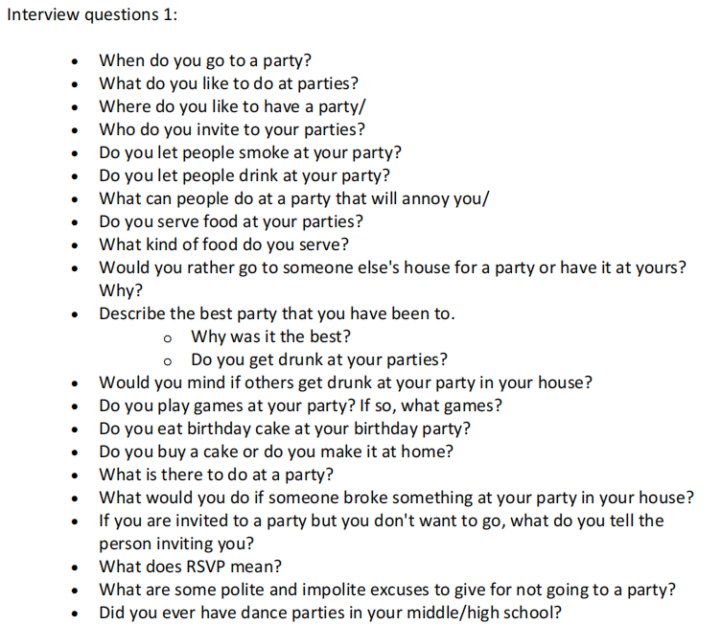
Interview Questions 1

Slide 66
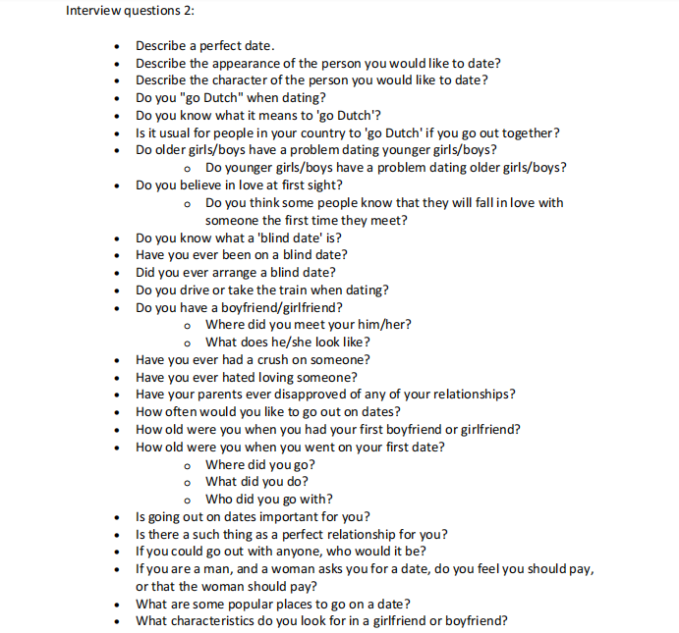
Interview Questions 2

Slide 67
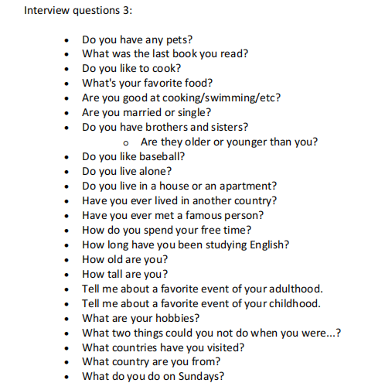
Interview Questions 3

Slide 68
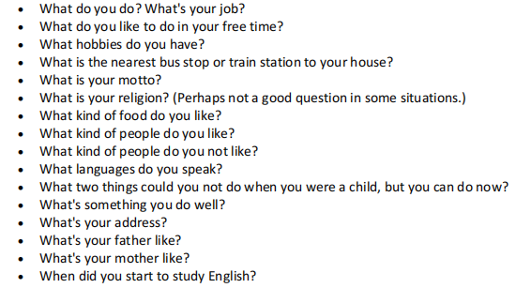
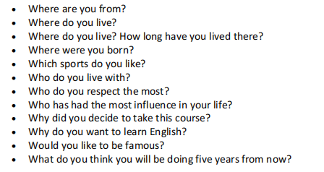
Interview Questions 3

Slide 69
THANK YOU
Elva

